Slide 1
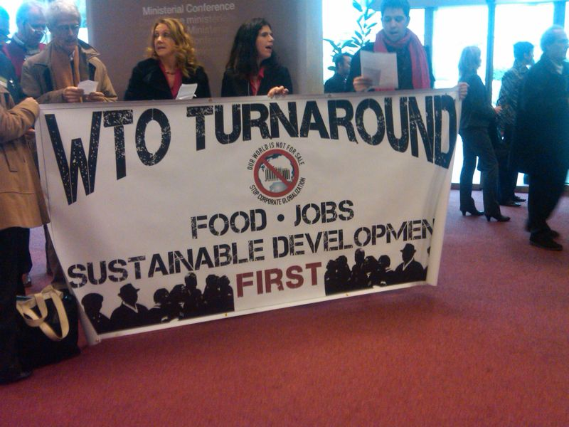
ERE11 – Trade & the Environment
Domestic environmental policy and the World Trade Organization
Free trade and targets of environmental protection
Trade sanctions and environmental protection
Waste and recycling

Slide 2
1 Sustainability (RT)
2 Ethics (RT)
3 Externalities and optimality (RT)
4 Valuation: Aims and purpose (GM)
5 Valuation: Revealed preferences (GM)
6 Valuation: Stated preferences (GM)
7 Targets for environmental policy (GM)
8 Cost-benefit analysis (RT)
9 Instruments for environmental policy (RT)
10 Environmental policy instruments (RT)
11 Trade and the environment (RT)
12 Environmental accounting (GM)

Slide 3
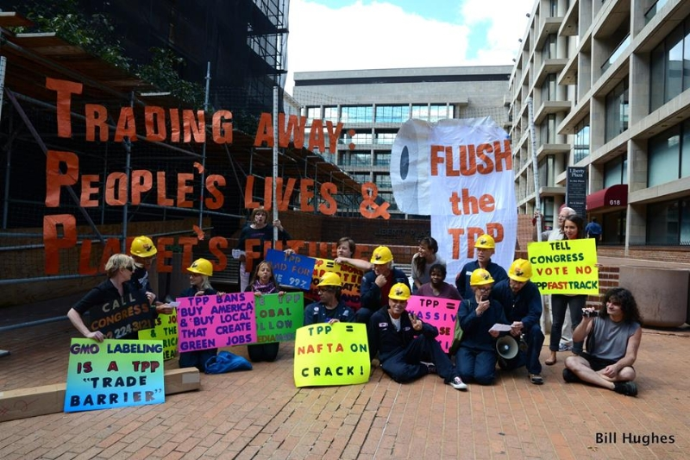
The Problem
Environmental policy regulates production, consumption and waste
As goods are internationally traded, countries‘ environmental policies affect each other
As environmental problems are increasingly international, countries‘ trade policies affect the environment
Unfortunately, this has led to conflict – international trade and environmental protection are widely seen as contradictory

Slide 4
Domestic Policy & WTO
WTO Members are free to set domestic (environmental) policy, be it with regard to production standards or product characteristics
WTO Members are free to set the same standards on product characteristics of imported goods, provided that this is done in a non-discriminatory way
This implies that countries cannot put the burden of environmental regulation on foreign industries

Slide 5
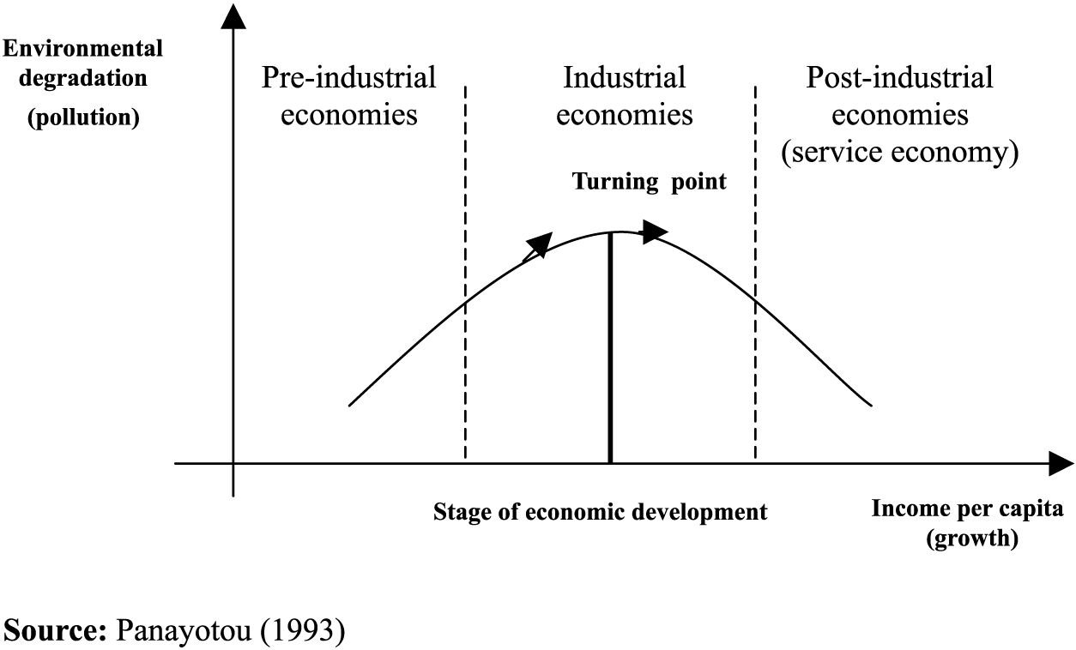
Growth and the Environment
Trade policies seek economic growth
Growth is hard needed in a lot of places, but international trade policies favour growth in rich places
Growth has three effects:
More economic activity means more resource use, more emissions
More money means more money to pay for environment protection
A higher income implies a higher demand for a clean environment

Slide 6
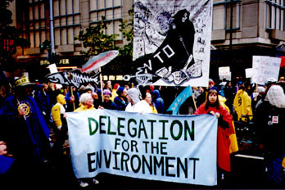
Domestic Environmental Policy and the WTO
Environmentalists‘ argument: The obligations under the WTO agreements prevent the attainment of legitimate domestic environmental policy goals; environmental policies should therefore be exempted from WTO obligations
As there is little economic activity that is not touched by environmental policy, this could undermine the WTO

Slide 7
Domestic Policy & WTO -2
For example, the US Clean Air Act specifies the allowed sulphur content of gasoline; this was thrown out by the WTO because domestic producers could use individual baselines, whereas foreign producers had to use an average baseline
For example, the WTO threw out a US attempt to regulate tuna imports from Canada on environmental grounds whilst not regulating domestic tuna fishing

Slide 8
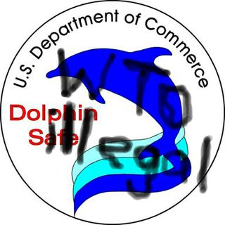
Domestic Policy & WTO -3
The WTO also threw out a US attempt to regulate tuna fishing in the Philippines to US standards
A unilateral import embargo was not „necessary“ for the protection of dolphins as long as the US „had not exhausted all options reasonably available to it ... in particular through negotiation“
„the embargoes on tuna were taken by the US so as to force other countries to change their policies with respect to persons and things within their own jurisdiction“

Slide 9




Domestic Policy & WTO -4
The WTO allows regulation within a country‘s jurisdiction; destination not origin; product not production
Recently, the WTO allowed eco-labels, that is, countries can now oblige producers to display information on production methods
This reflects countries‘ sovereignty, and it extends to the environmental resources on a country‘s territory

Slide 10
Domestic Policy & WTO -5
GATT II:2(a) „nothing in this Article shall prevent any contracting party from imposing at any time on the importation of any product a charge equivalent to an internal tax (if non-disriminatory) [on] the like domestic product or in respect of an articles from which the imported product has been manufactured or produced in whole of in part“
So, border tax adjustments are allowed, in principle

Slide 11
Domestic Policy & WTO -6
GATT III (note): „any internal tax ... which applies to an imported product and to the like domestic product and is collected ... at the time of importation is ... to be regarded as an internal tax“
GATT III:2: „products ... imported ... shall not be subject, directly or indirectly, to internal taxes ... in excess of those applied, directly or indirectly, to like domestic products“

Slide 12
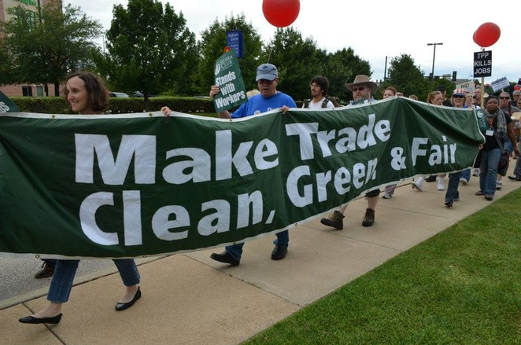
Domestic Policy & WTO -7
Countries may use border tax adjustments on exports (i.e., exempting export goods from domestic charges) as well as import (i.e., levying taxes on imported goods)
Problems arise if domestic and imported products are produced with different techniques – are imported products taxed or banned because of their characteristics, their production processes, or to protect domestic producers?

Slide 13
Domestic Policy & WTO -8
EU ETS recently extended to aviation: Planes landing in EU / taking off from EU pay for CO2 emitted for entire flight, regardless of destination
US carriers took EU to court (not WTO, as aviation regulated elsewhere) and lost: There is no discrimination
Note that court thus established that emissions outside jurisdiction may be regulated for global issues
Permit trade was suspended nonetheless, because rules favour Middle Eastern airlines

Slide 14

Trade &Targets
Environmentalists‘ argument: The principle of open markets of the WTO leads to a race to the bottom, forcing all WTO members to lower their environmental standards to the level of the WTO member with the lowest standards; WTO members should therefore be allowed to offset through trade controls the economic impact of diffences in environmental standards

Slide 15
Trade & Targets -2
As we have seen, countries can enforce the same product characteristics on domestic and imported products
This is not true for production processes
If a country accepts lower standards on environmental protection for its industries, it lowers production costs and improves its competitive advantage
If this is a purely domestic affair, there is little other countries can do about it through, e.g., border tax adjustments

Slide 16
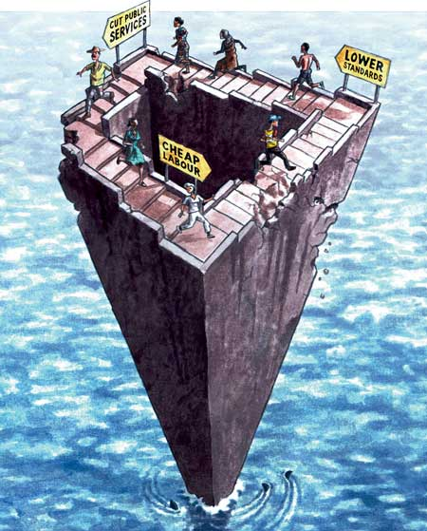
Trade & Targets -3
Countries may use lax environmental regulation to gain competitive advantage
This would lead to higher costs of environmental protection in other countries, and may lead to lower environmental standards
This „race to the bottom“ would lead to miminal environmental standards everywhere
Or would it?

Slide 17
Trade & Targets -3
Experience suggests that countries adopt different environmental protection targets
If a country wants to grow rich by being dirty, that is their business; however, most countries prefer to be less rich and clean
Competition on environmental protection leads to maximum welfare, not minimum environment
Moreover, environmental protection is often only a fraction of the costs of production
Besides, environmental taxes are revenue

Slide 18
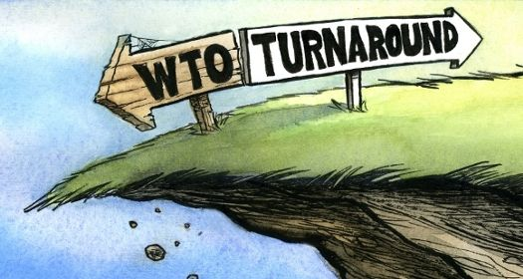
Trade Sanctions & Environmental Protection
Environmentalists‘ argument: The WTO prevents the use of trade sanctions to force WTO members to raise their environmental standards; the rights of market access under the WTO should therefore be linked to commitments to raise environmental standards
Presumption: Environment is more important than trade

Slide 19
Trade Sanctions
Trade sanctions are not allowed by the WTO
Trade sanctions are painful, and may be used as a threat to countries who prefer lower environmental protection
Again, this would infringe on sovereignty
Trade sanctions are part of the Montreal Protocol to protect the ozone layer, but never used – some argue that they are essential for deterring free-riding – note that the Montreal Protocol bans exports, not imports

Slide 20
Trade Sanctions -2
If a group of countries can use trade sanctions to bully another country into environmental regulation, then a group of countries can use environmental sanctions to bully a country into accepting unfavourable trade conditions
Nonetheless, trade and environment interact, and so should their international regulatory bodies
The real problems are lack of political will and bureaucratic divisions

Slide 21
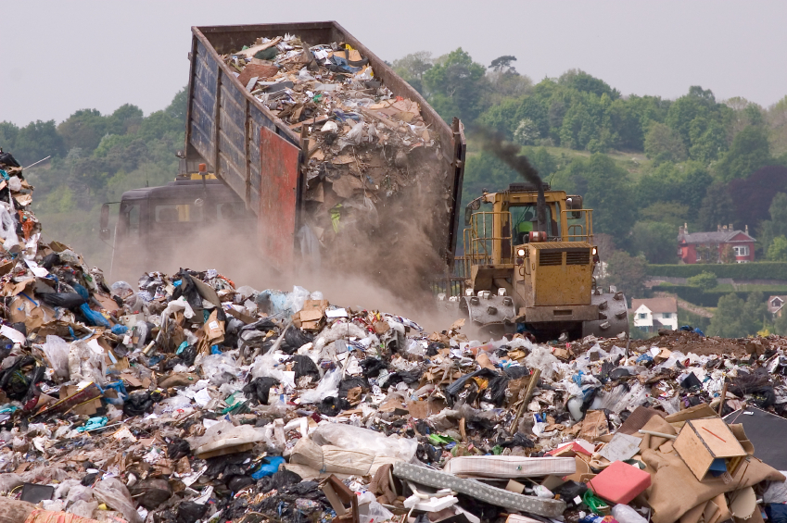
Waste and Recycling
Although waste is not really different from other commodities, it is treated differently
If a country wants to accept another country‘s waste, that‘s that country‘s business; if a country wants to sacrifice its pristine environment for economic growth, who are we to object?
In fact, it is economically efficient to spread waste around so that it does equal marginal damage everywhere ...

Slide 22
Waste and Recycling -2
However, waste is not a WTO-recognized commodity, so it escapes WTO regulation
The export of several types of hazardous waste is now forbidden to countries who are deemed not to have the appropriate waste handling technologies
Even if waste would be part of the WTO, this is an export barrier not an import barrier
The argument is that a lot of waste ends up in illegal dumps (at destination)

Slide 23
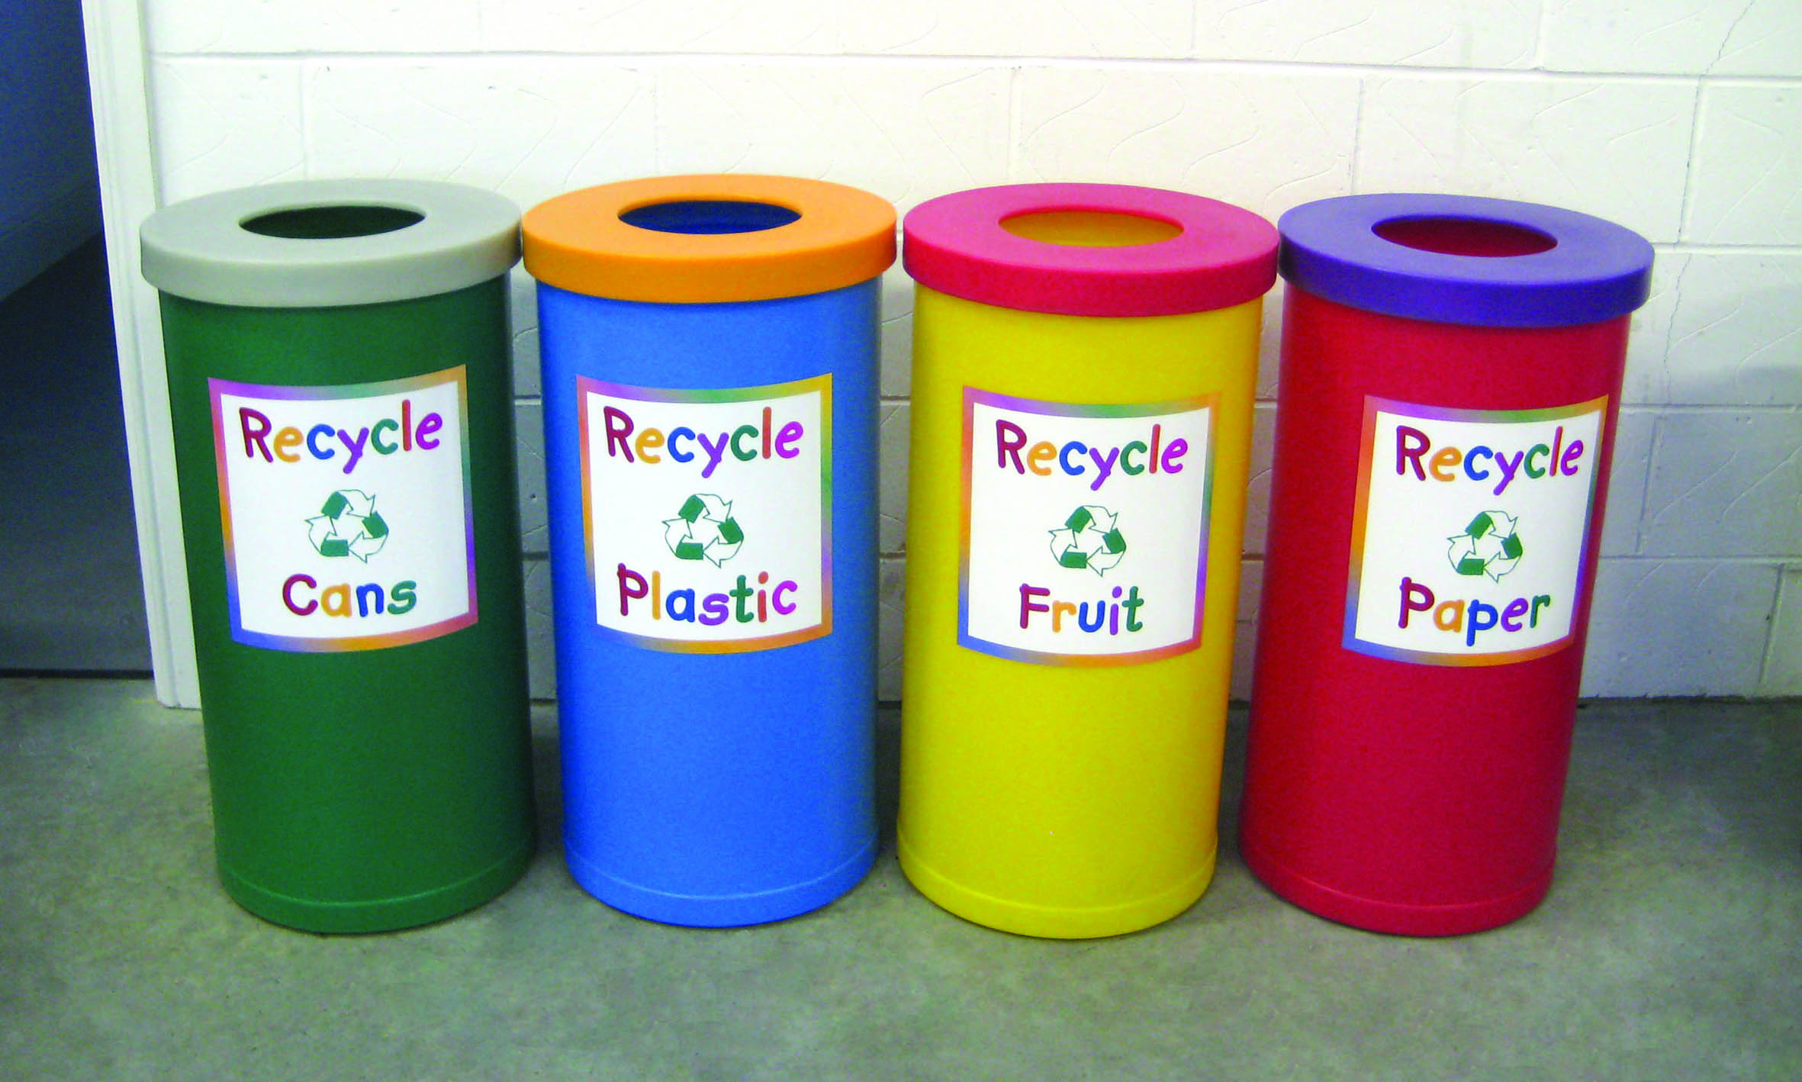
Waste and Recycling -3
Recycling is different story
Waste products are often good sources of secondary materials, such as paper, plastics, metals
Secondary materials are lower quality but also cheaper than primary materials
Hence, secondary materials are quite popular in developing countries
Transport is cheap, as a lot of bulk commodities flow from South to North

Slide 24
Market Share of Secondary Commodities in International Trade
 | 1970-74 | 1995-97
Aluminium | 4% | 13%
Copper | 24% | 37%
Lead | 12% | 22%
Nickel | 8% | 8%
Paper | 13% | 27%
Plastics | 3% | 4%
Iron | 14% | 7%
Tin | 13% | 20%
Zinc Tires | 2% 14% (91) | 4% 17% (97)

Slide 26
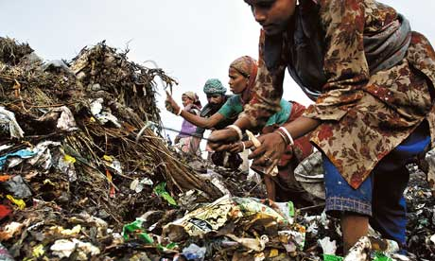
Waste and Recycling -4
Secondary materials are not very popular here, so instead of recycling, inciniration and land-filling are the preferred waste disposal methods
Particularly for plastics, as sorting plastic is labour-intensive
So, exporting recyclable material is good for the environment, good for development, and cheaper

